Slide 1
Welcome to the Office of Student Accounts
What do we do?
Billing for Tuition, Fees, Room and Board
Collect Payments
Issue IRS Tax Forms

Slide 2
Important Information in our Handouts
Office hours and contact information
Critical deadlines
Monthly payment plans
Academic year tuition rates
Step-by-Step Instructions

Slide 3
FERPA Waiver and Authorized Users
FERPA Waiver
Paper form submitted to Registrar that grants full access to financial data, grades, etc. via the phone or in-person.
Remember the security question and answer!
Authorized Users
Grants online access to financial data ONLY
Parents will receive emails when bills are issued and can make online payments and join the monthly payment plan

Slide 4
Billing Statements
Paperless billing, statements only available online
Bills are term specific and generated weekly if you have a balance
Authorized users will receive a notification when bills are generated
Fall 2024 payment is due on August 15, 2024
Please check that all of the financial aid that you were expecting is reflected on the bill. If not, please contact finaid@ramapo.edu

Slide 5
Waivers and Deadlines
Student Medical Insurance
Premium: $2,704.00 for coverage that runs from August 2024 – July 2025 but can be waived if you have your own insurance
The insurance waiver deadline is September 27, 2024
Please allow two business days for waiver to appear on the account
Parking Waivers
Parking charge: $200 (plus tax for commuters). Covers both the Fall and Spring semesters, but can be waived
The parking waiver deadline is September 27, 2024
Please allow one business day for the waiver to appear on the account

Slide 6
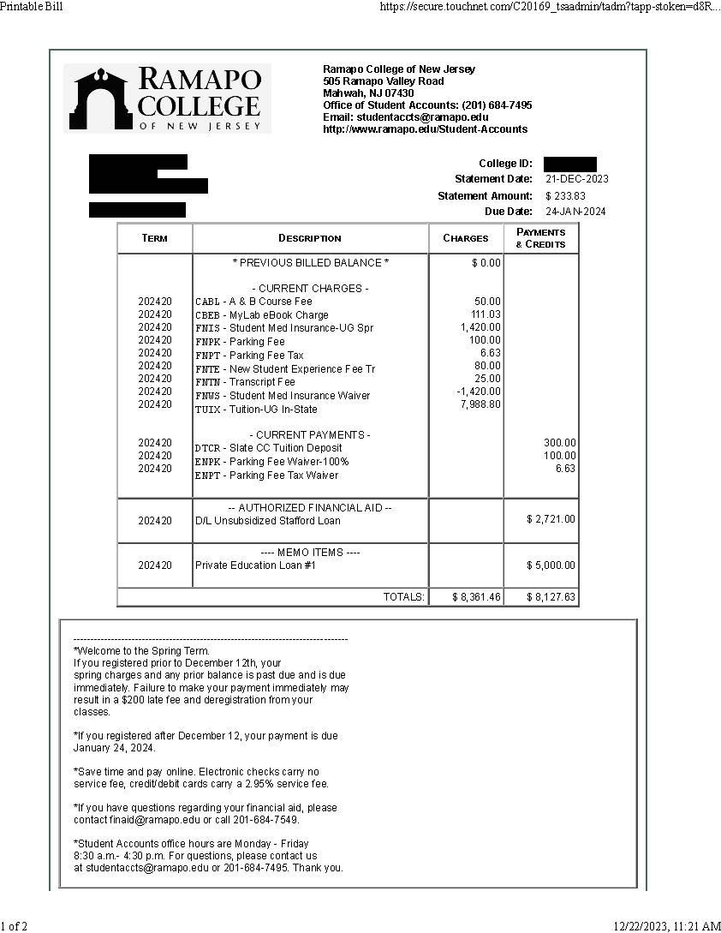
Sample Bill
*Medical Insurance Waiver reflected as a NEGATIVE Charge
*Parking Waiver reflected as a credit
Bill are sent out weekly if you owe (no bills will be sent if on a payment plan)
View each bill as account and messages may change
*Financial Aid is NOT finalized on your bill and can change!
*Important information and more deadlines

Slide 7
Payment Options
Payment plans
5 Installment Plan: July 15th to November 15th with a 20% down payment due at time of enrollment
4 Installment Plan: August 15th to November 15th with a 25% down payment due at time of enrollment.
Service fee of $60 to join plan
Late Payment Fee of $35
On-line
Credit/debit cards which carry a 2.95% service fee
ACH payments carry no service fee
In-Person/Mail
Checks,money orders
Cash payments in-person only
Late Payment
$200 late fee and/or dropped from courses for non-payment

Slide 8
Other Payment Options
529 Payments
Can be sent home or to the College
Email proof of payment to OSA. If the proof shows that payment will be made payable to Ramapo College and covers the balance, the student will not be assessed late fees
Outside Scholarships
Donor letters and payments can be mailed or dropped off in the OSA
Checks made payable to the student can be cashed by the student
Wire Transfers
Third party company – PayMyTuition https://payment.paymytuition.com/paynow/ramapo

Slide 9
Book Advance and Student Refunds
Book Advance (used for books and educational supplies)
Students that have financial aid which creates a credit balance on their account, can request a line of credit at the book store by contacting finaid@ramapo.edu
The Follett bookstore offers price matching
Student Refunds
Students that have a Fall credit balance will be refunded after the start of the semester or after financial aid is disbursed in early October
Sign up for direct deposit!

Slide 10
Tuition Protection Insurance
Ramapo College has partnered with GradGuard to provide you with an option for tuition insurance from Allianz Global Assistance.
This coverage expands the scope of the College’s refund policy by ensuring reimbursement for tuition, room, board and other fees for covered withdrawals at any time during the semester.
Example: A $20,000 policy costs approximately $220
In order to learn more, please visit GradGuard.com/Tuition/Ramapo or call 1-877-794-6603

Slide 11
We Are Here to Help!
Office Hours:
Semester – Monday to Friday 8:30 a.m. to 4:30 p.m.
Summer – Monday to Thursday 8:00 a.m. to 5:15 p.m.
Location:
Main Academic Building D – Room 128 (1st Floor)
Contact Info:
P: (201) 684-7495 Email: studentaccts@ramapo.edu
*If you would like to schedule a meeting in-person, via WebEx, or request a conference call we would be happy to accommodate your request.

Slide 12
Office of Financial Aid
What do we do?
Federal and Private Loans
Federal and State Grants
Ramapo Scholarships

Slide 13
Financial Aid
You must complete a 2024-2025 FAFSA form to be considered eligible for a Federal Direct unsubsidized loan
You must enroll in 6 or 8 credits each semester to be eligible to use your federal student loans and a partial Pell grant
You must be enrolled in 12 or more credits to be eligible for an NJ Tag Grant

Slide 14
Student Loans
All student loans are applied directly to your students account
In addition to the federal direct students loans from FAFSA, there are two additional loan options
1) A Parent Plus Loan, which can be applied for at www.studentaid.gov. This loan has an 9.083% interest rate and a 4.284% origination fee
2) An Alternative/Private Loan, which can be applied for at www.elmselect.com. The interest rates fixed range from 4.49% to 16%
Rates will be finalized by 7/1/2024

Slide 15
Accepting Your Loans
Please be aware, students must now Accept or Decline Federal Direct Loans through the Ramapo College Self-Service. Your loan will not appear on your bill until you do so. Please follow these instructions:
Log into Ramapo College Self-Service with your Ramapo Email username and password
Select “Student Services & Financial Aid” and “Financial Aid”
Select “My Award Information” and “Award by Aid Year”
Choose Award Year 2024-2025
Select “Accept Award Offer” tab
The Award Overview tab is a summary of your financial aid package. The Terms and Conditions tab provides you with important information about your awards. The “Accept Award Offer” tab is where you must choose to accept or decline your loans.

Slide 16
Reminders
Once you have accepted your Federal Direct Student Loan make sure to go to www.studentaid.gov to complete online Entrance Counseling and your Loan Agreement for a Subsidized/Unsubsidized Loan (MPN)
Plus loan borrowers will need to complete a plus loan MPN at www.studentaid.gov

Slide 17
The Office of Financial Aid
Our office is located in E-210
Our general inquiry email is finaid@ramapo.edu
Documents can be submitted to finaiddocs@ramapo.edu
Our main office phone number is 201-684-7549
Summer office hours are Monday to Thursday 8:00-5:15 and Monday to Friday 8:30-4:30 during the Fall and Spring semesters.

Slide 18
Questions?
We are here to help!

