Slide 1
POWERING BACK TO CAMPUS WITH

Slide 2
FEATURES
Assigning Modules
SpeedGrader Screen Capture
‘Message Students Who’ Changes
Inbox Improvements
Smart Search & Discussion Summaries
Mobile Offline Support
Analytics Hub
Studio Automatic Publishing of Captions
Lucid Integration

Slide 3
Assigning Modules
Personalized Learning
What Changed?
Previously, instructors and course designers could assign only quizzes, assignments, and graded discussions to specific students and/or sections. Now, educators can:
Assign entire modules, pages, quizzes, assignments, graded and ungraded discussions to individual students and sections.
Manage course object assignments, availability, and due dates for all object types, directly from the Module Index page.
Why?
Granting educators additional control over course object availability can lead to more effective differentiated instruction and personalized learning experiences for every student.
How to Enable?
It’s live! No steps are needed to begin using this new feature.
Want to Learn More?
How do I assign a module to individual sections or students?
How do I assign a module content item from the Module Index page?
Release Notes
Back to Table of Contents

Slide 4
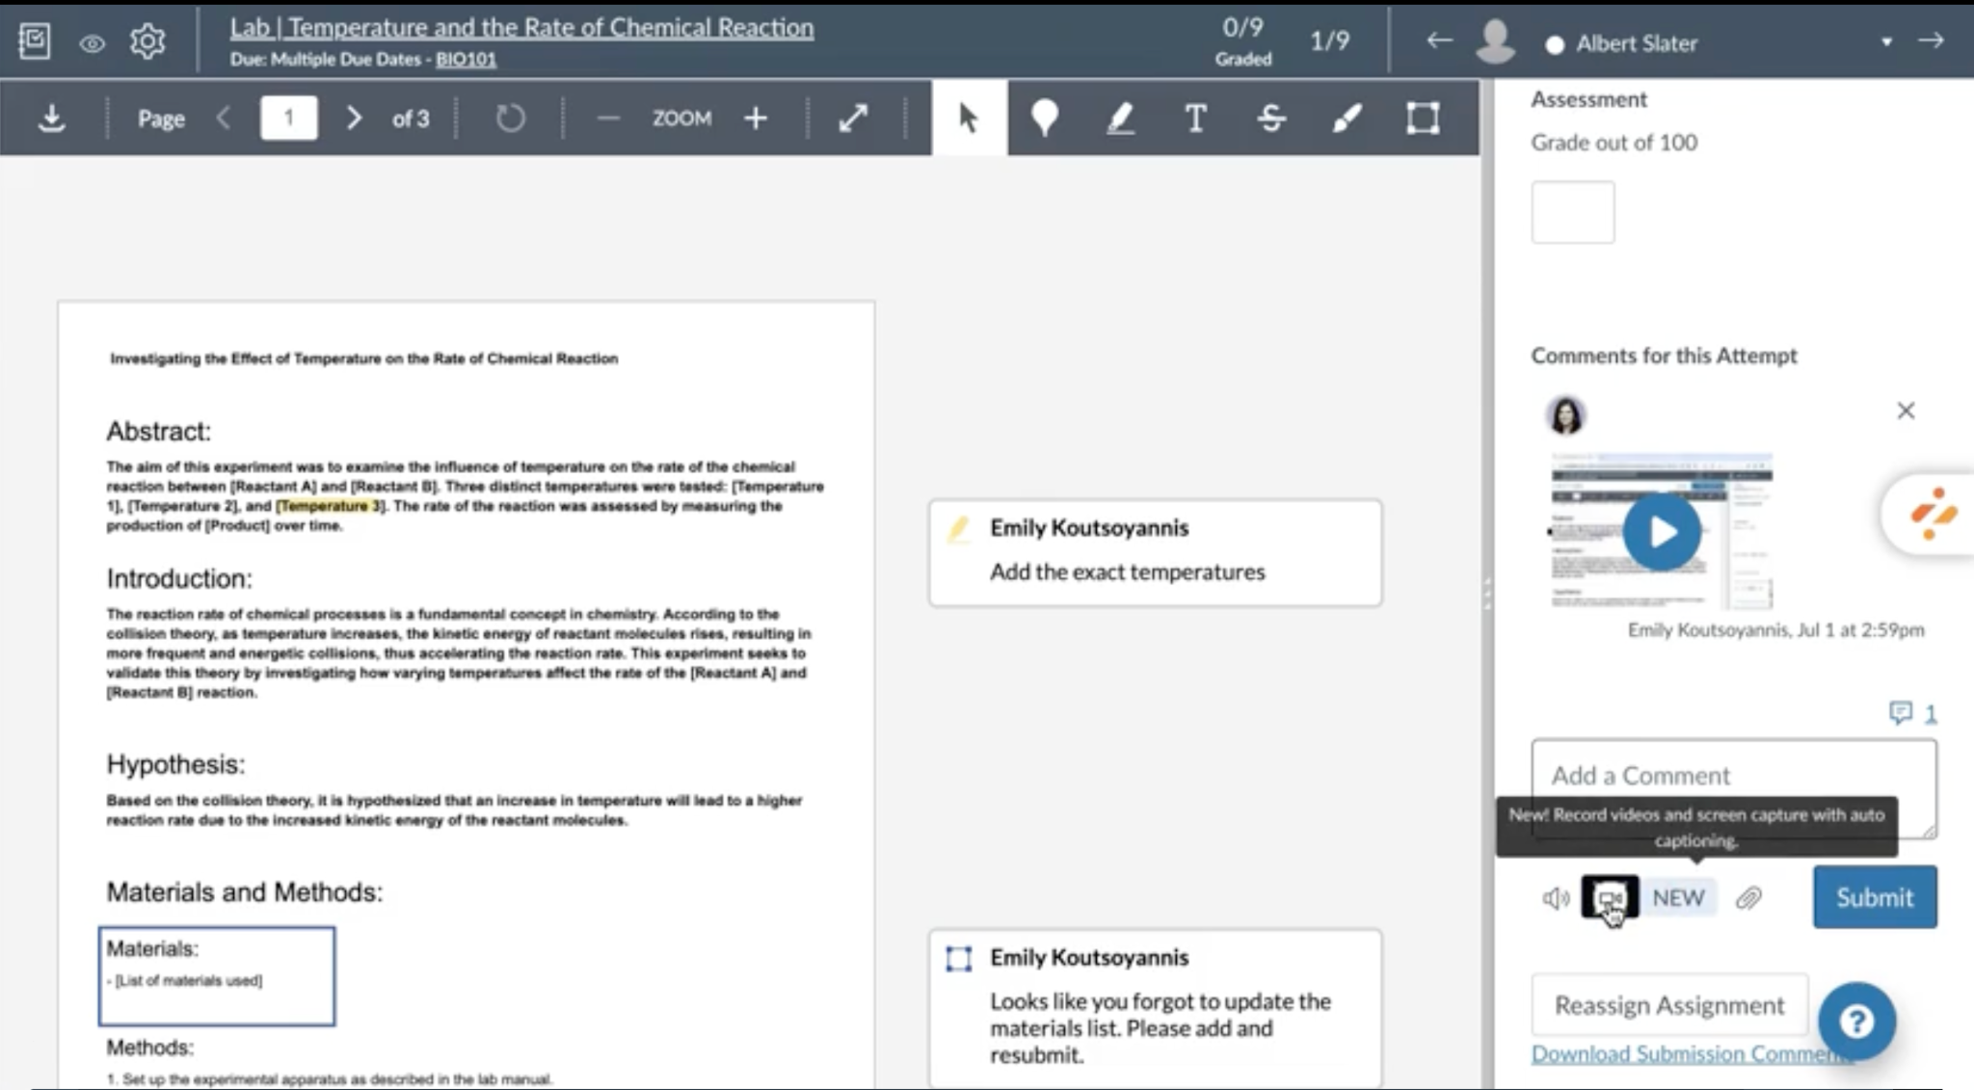
SpeedGrader Screen Capture
Personalized Learning
What Changed?
Educators can now take screen captures directly within the SpeedGrader as an additional form of student feedback, alongside DocViewer annotations and recorded media feedback.
Why?
This change enhances the clarity of instructor feedback through visual demonstrations and clear, accessible audio captions.
How to Enable?
It’s live! No steps are needed to begin using this new feature. Please note, the screen capture recorder is only available in Chrome and Edge browsers.
Want to Learn More?
How do I record a webcam video, screen capture, or audio recording as a feedback comment in SpeedGrader?
Release Notes
Back to Table of Contents

Slide 5
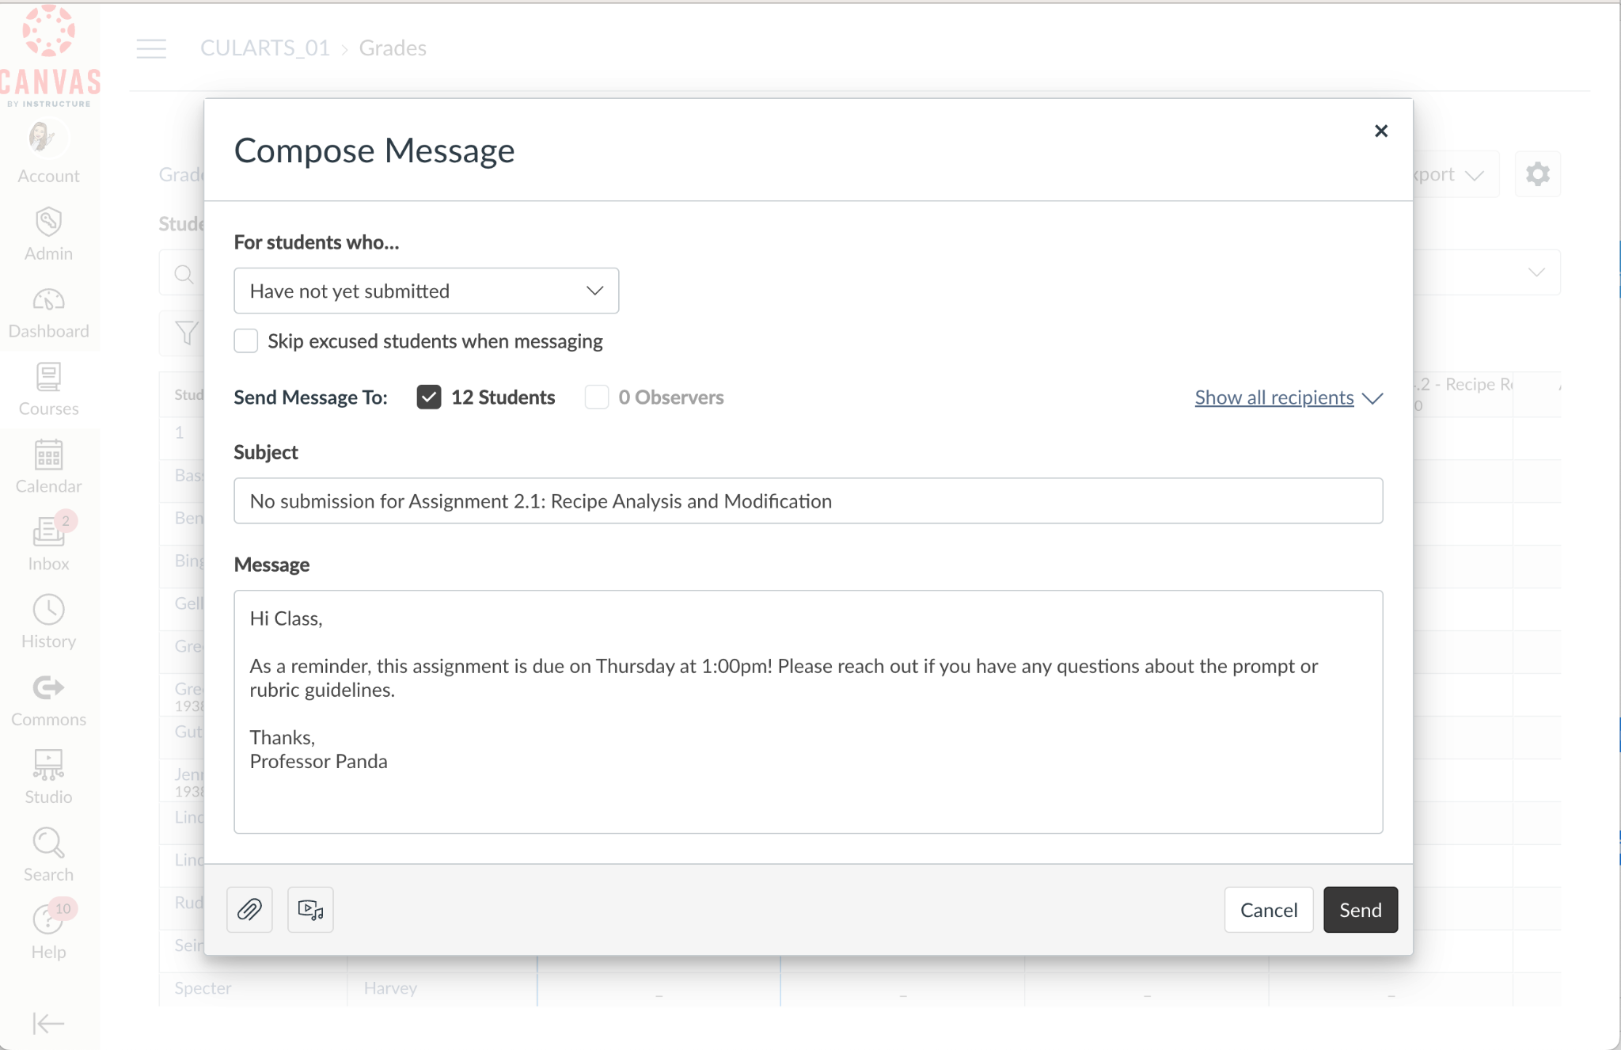
Message Students Who
Enhancements
Enhancing Grading and Feedback
What Changed?
The ‘Message Students Who” functionality has been updated:
Using the Gradebook Total column, educators can now communicate with students based on Total Grade results.
Instructors can target students who have, or have not submitted a particular assignment.
Additional options are messaging students with graded submissions, students with ungraded submissions, and the ability to exclude students who have excused assignments.
Why?
To provide educators with greater efficiency in communicating with their students, based on individual student behaviors and grades within the course.
How to Enable?
It’s live! No steps are needed to begin using this new feature.
Want to Learn More?
How do I send a message to students from the Gradebook?
New Features, Big Impact: Enhancing Common Workflows in Canvas LMS Product Blog
Back to Table of Contents

Slide 6
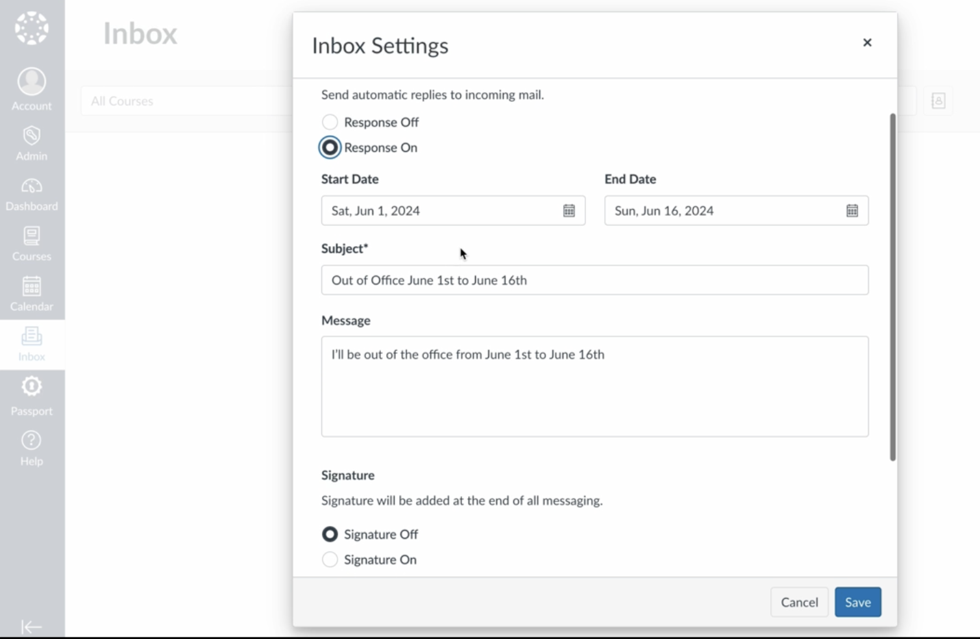
Inbox Improvements
Simplifying Educator Workflows
What Changed?
From the new Inbox Settings menu, instructors can:
Set up out of office messages.
Add message signatures.
Have access to Inbox settings via a new gear icon on their Inbox page.
Why?
We implemented these changes to improve the Inbox experience by adding features that feel more familiar, like those in traditional email systems.
How to Enable?
If enabled by your institution, no steps are needed to begin using this new feature.
Want to Learn More?
How do I manage my Inbox settings as an instructor?
Release Notes
Feature Screencast
New Features, Big Impact: Enhancing Common Workflows in Canvas LMS Product Blog
Back to Table of Contents

Slide 7
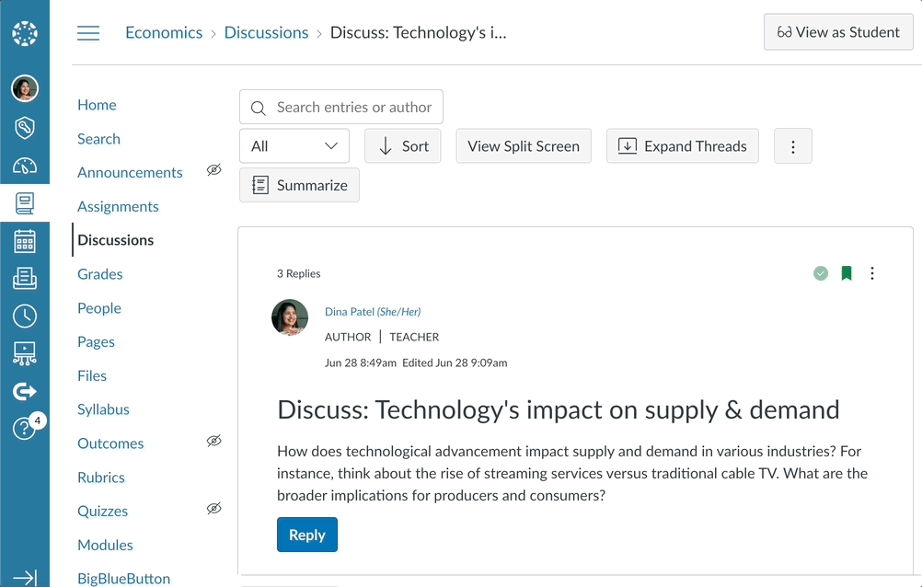
Smart Search & Discussion Summaries
Driving Efficiencies through AI
What Changed?
Smart Search allows users to search Canvas course content, using semantic algorithms and AI embeddings. Smart Search understands the context of queries and provides relevant results.
Discussion Summaries provide educator-facing summaries of key points and questions in their discussions.
Why?
Smart Search makes searching Canvas course content more efficient for students and teachers.
Discussion Summaries accelerate educators' ability to grasp central themes and questions emerging from discussion threads.
How to Enable?
Via Feature Options, “Smart Search” and “Discussion Summary”.
If you do not see the functionality, these features may not have been enabled by your institution.
Want to Learn More?
Deploy Notes
AI Nutrition Facts: Making Informed Decisions About Your AI Tools
Smart Search
Discussion Summaries
User Groups:
Smart Search
Discussion Summaries
Back to Table of Contents

Slide 8
Mobile Offline Support
Differentiating Student Learning
What Changed?
If enabled by administrators, students can download course content to the Canvas Student app for offline consumption. This excludes the ability to take action in course items such as quizzes, assignments, or discussions.
Why?
We recognize that not all users have consistent or reliable internet access. By downloading course materials for offline use, students can access their course content even without a reliable connection. Furthering our commitment to providing equitable Teaching and Learning solutions.
How to Enable?
If enabled by your institution, students can select and download specific courses and/or course elements via their Canvas Student Mobile App.
Want to Learn More?
User Guides:
How do I view course content offline in the Student app on my iOS device?
How do I view course content offline in the Student app on my Android device?
Release Notes
Mastering Offline Functionality
Back to Table of Contents

Slide 9
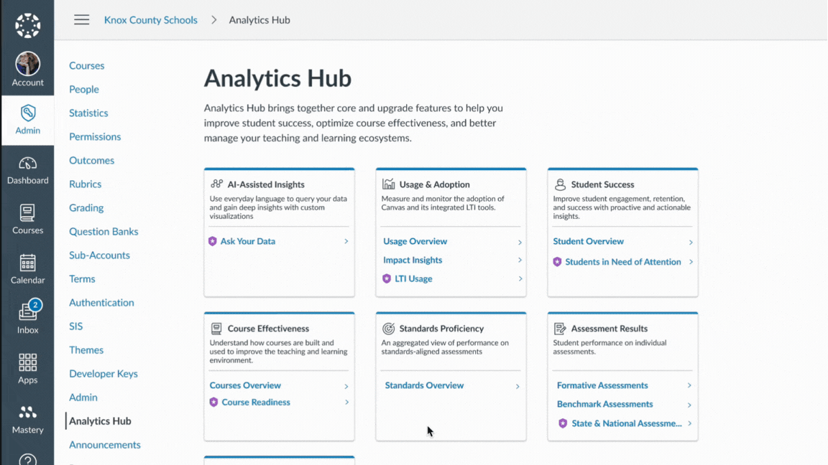
Analytics Hub
Providing Clarity through Insights
What Changed?
A new, one-stop-shop UI for Admins to access all of the reporting available to them across Instructure products. This includes both standard and advanced offerings.
Why?
Having a consolidated place to view reporting can increase educational impact with access to a range of Insights.
How to Enable?
It’s live! No steps are needed to begin using this new feature.
Want to Learn More?
How do I use Analytics Hub to access all my Instructure data from one place?
Release Notes
Introducing Analytics Hub Blog Post
Back to Table of Contents

Slide 10
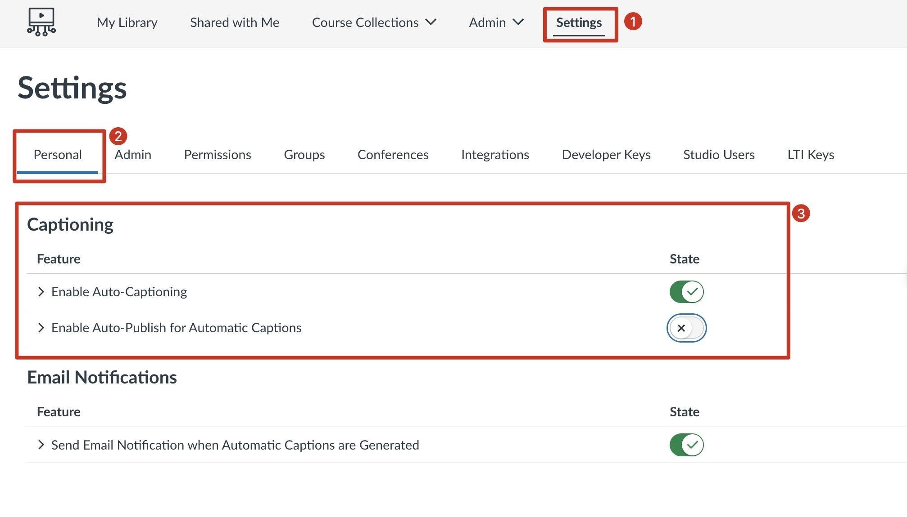
Studio Auto Publishing of Captions
Simplifying Educator Workflows
What Changed?
Captions for recorded or uploaded Studio Media will now be automatically created. Additionally, Studio users can choose to have the captions auto-published to their Studio Media through new settings.
Why?
This update lightens the load for educators by automatically generating and automatically publishing those captions. It saves them time and ensures content is accessible to all learners.
How to Enable?
Auto-Caption is on by default unless your institution has disabled it. Auto Publish of those automatic captions can be enabled in your Studio Settings > Personal settings tab.
Want to Learn More?
Release Notes:
Automatic Caption Generation
Auto-Publishing Captions
Studio Automatically Captions Any Uploaded Media From Today!
Learnings on Studio Auto Captioning And What It Means For You
How do I add auto-generated captions to my media file in Canvas Studio?
How do I view the Settings menu in a Canvas Studio site?
Back to Table of Contents
Notes:
Notes: Auto Captions are available for media recorded or uploaded to Studio since March 25. A setting to enable Auto Publishing of those captions came out in July.
YouTube and Vimeo media embeds in Studio continue to require caption file uploads or manually created captions.

Slide 11
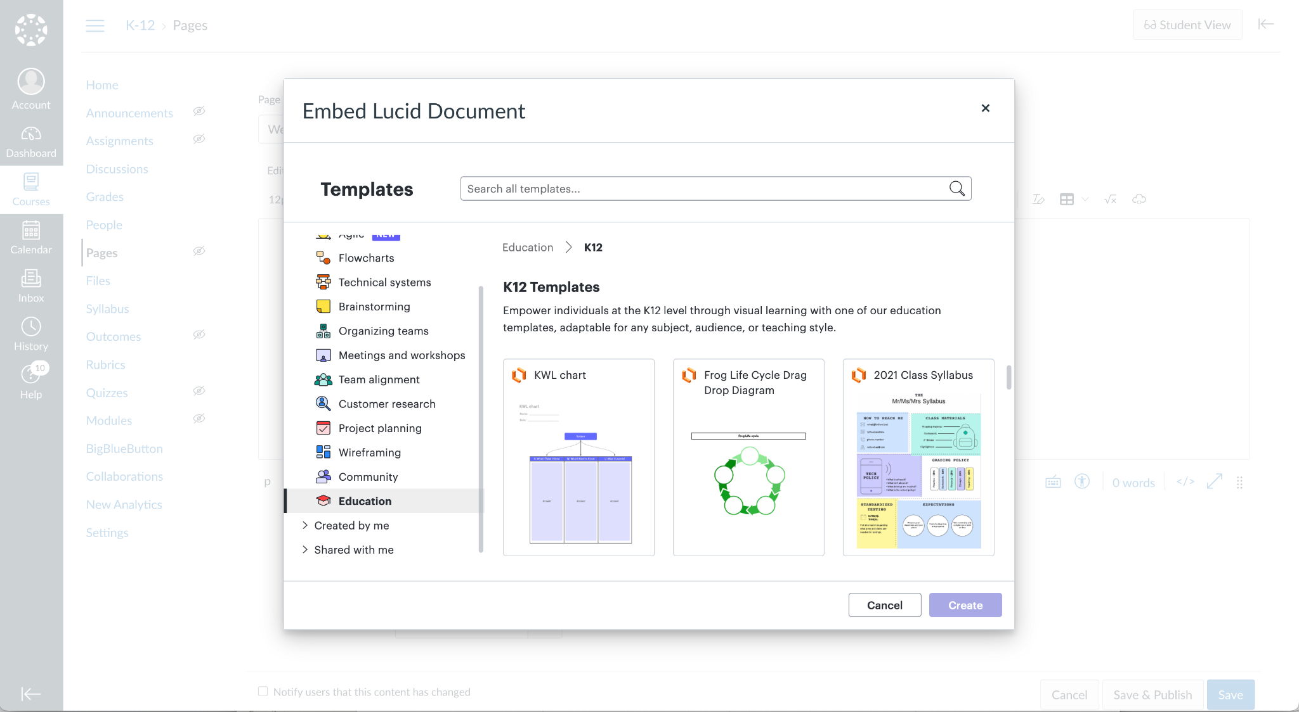
Lucid Integration
Differentiating Student Learning
What Changed?
A free and exclusive integration with Lucid Visual Collaboration Suite, available in the RCE, external tool assignments, and the Course Navigation.
Why?
Through our partnership with Lucid, educators can elevate student engagement and collaboration
How to Enable?
If the Lucid integration is enabled for your institution, you will be able to access LucidSpark and LucidChart via the Rich Content Editor (RCE), external tool assignments, and the Course Navigation.
Want to Learn More?
Canvas Release Notes (2024-06-15)
Canvas Release Notes (2024-08-17)
Getting Started with the Canvas and Lucid Visual Collaboration Suite
Demo Video: Accessing Lucid in Canvas
Demo Video: How to create a Lucid Assignment in Canvas
Demo Video: How to embed Lucid content and collaborative activities in Canvas
Back to Table of Contents

Slide 12
STILL HAVE QUESTIONS?
Do you have additional questions, or want to learn even more? In addition to your wonderful Account Team, here are resources for you to keep in your back pocket:
Back to Campus Website (HE)
Back to School (K12)
Product Blog
Canvas Releases
Studio Releases
Catalog Releases

