Slide 1
Civic Engagement events: Spring 2025
Co-Sponsored by the Civic and Community Engagement Center (CCEC), Student Government Association, and Faculty from Law and Society and Political Science

Slide 2
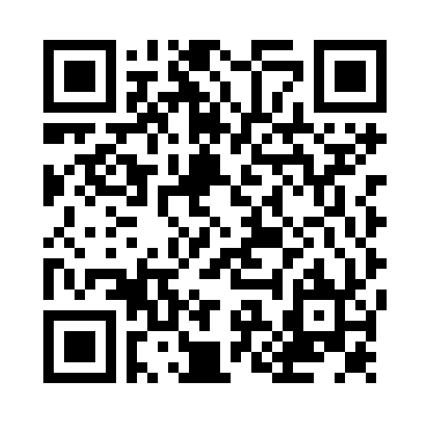
Teach-in: the civics you were never taught
Date: Thursday, March 27th
Time: 6pm – 10pm
Location: Friends Hall
Structure: 4 Panels will be presented:
  Constitution 101
  Rights
  Public Policy
  Student Response Panel
Interested in presenting? Fill out the form linked to this QR Code!

Slide 3
Civic engagement week: April 21-25
Monday, April 21: Panel Discussion w/ Local Civic Leaders
Tuesday, April 22: Ramapough Munsee Burial Ground Cleanup Event
Wednesday, April 23: Potential NJ Primary Event
Thursday: Second Teach-In Event: Trump First 100 Days (Evening)

